Slide 1

FOUNDATION OF DATA ANALYSIS

Slide 2



EXPLORATORY DATA ANALYSIS ON CarPrice.csv
DONE BY: SIVAPRASATH S
REG N0:RA2011047010118

Slide 3
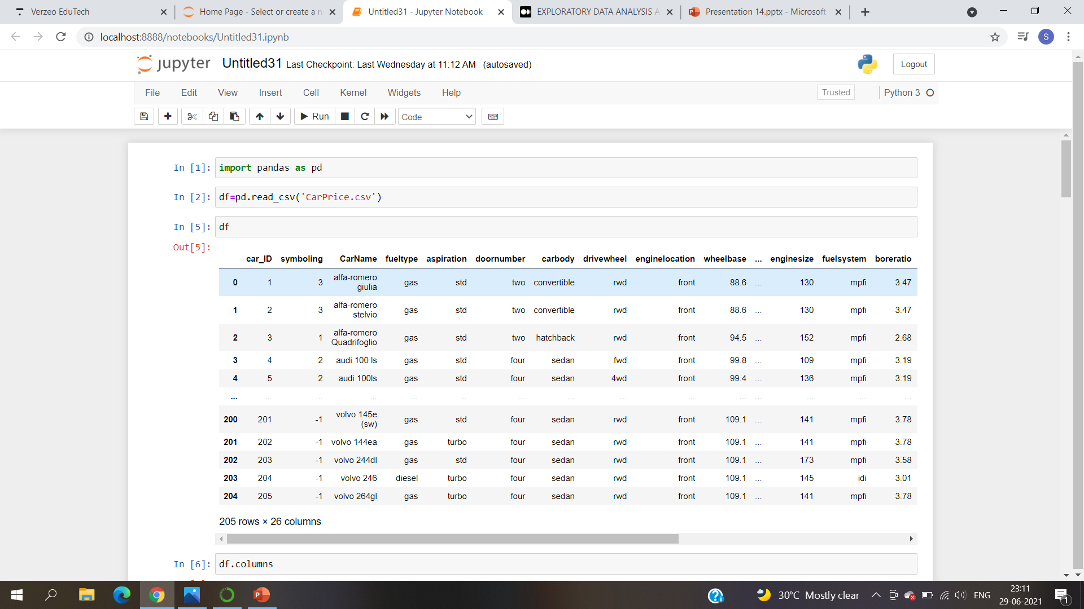
IMPORTING pandas library:

Slide 4
IMPORTING DATASET:

Slide 5
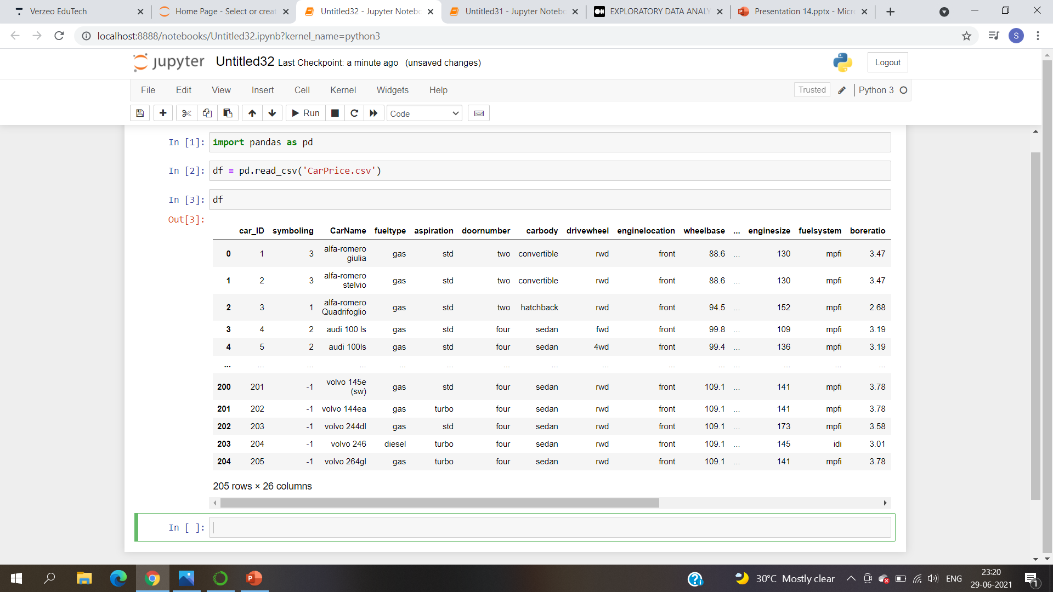

Slide 6
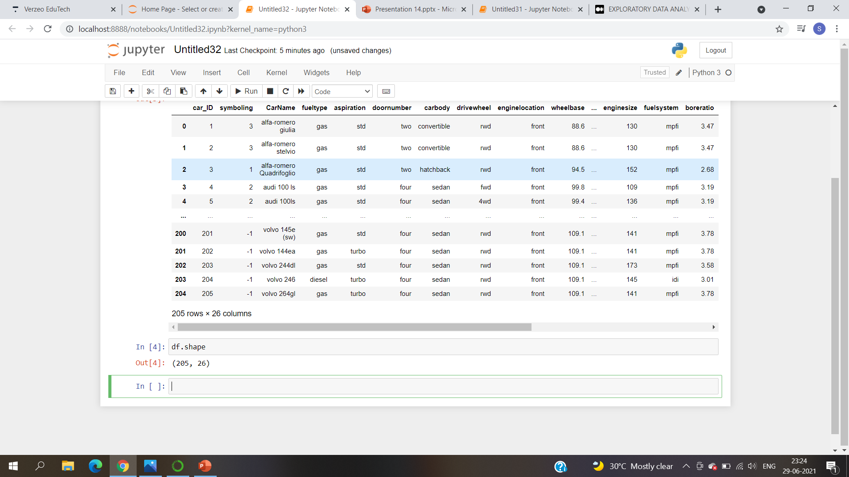
To find the dimension

Slide 7
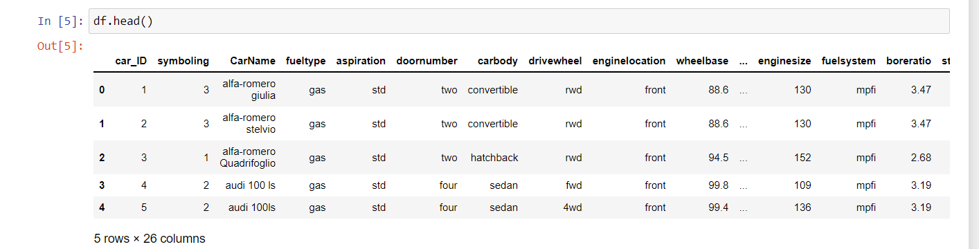
Understanding about attributes and target feature

Slide 8
Here the target feature is price

Slide 9
df.describe()
It is used to find the mean,standard deviation,minimum value,25%,50%,75%,maximum value
Only the columns with numerical values can be shown.
Helps to find 'OUTLIERS'

Slide 10
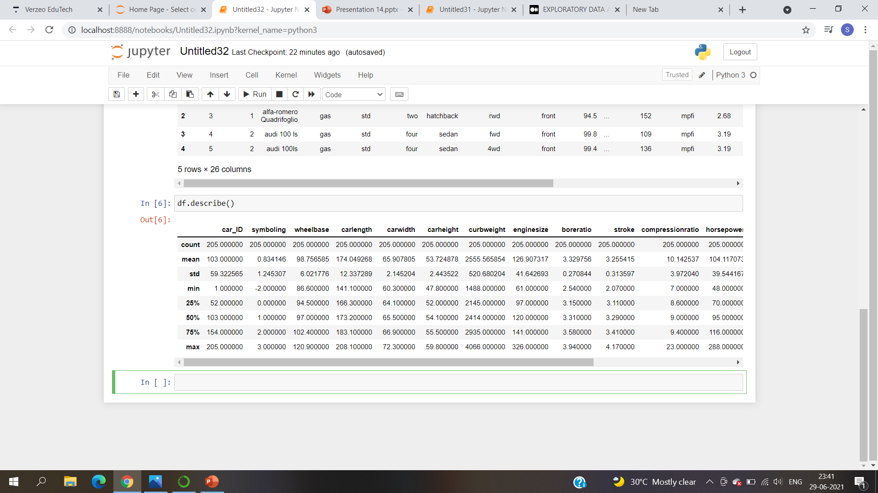
df.describe()

Slide 11
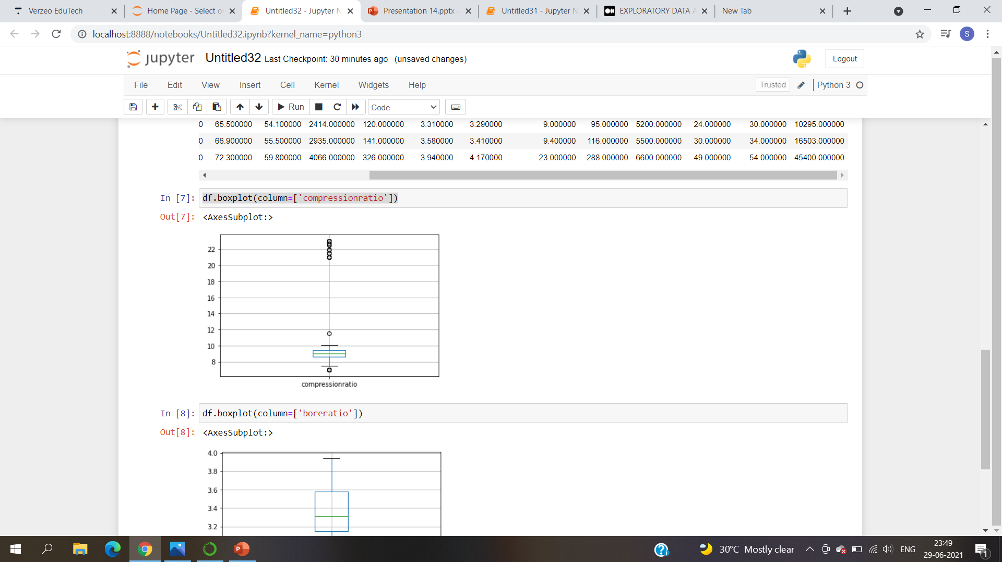
Using boxplot to find the outliers

Slide 12
df.info()
To find the number of columns, column labels, column data types, memory usage, range index, and the number of cells in each column (non-null values)
df.describe().columns
To get the columns with only numerical value.

Slide 13
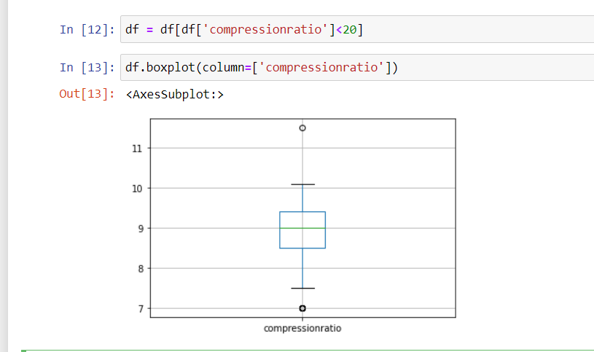
Removing the outliers ,I found the outliers in compression ratio is above 20, so removed the outliers

Slide 14
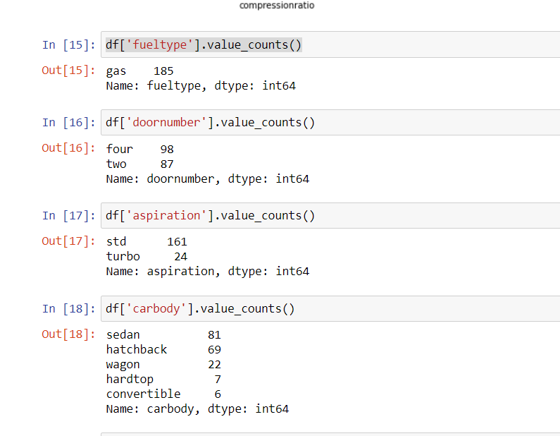
To get the counts of unique values in the columns which are categorical

Slide 15
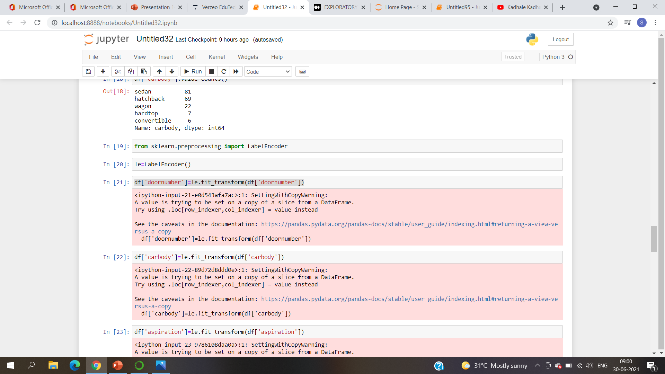
Importing LabelEncoder

Slide 16
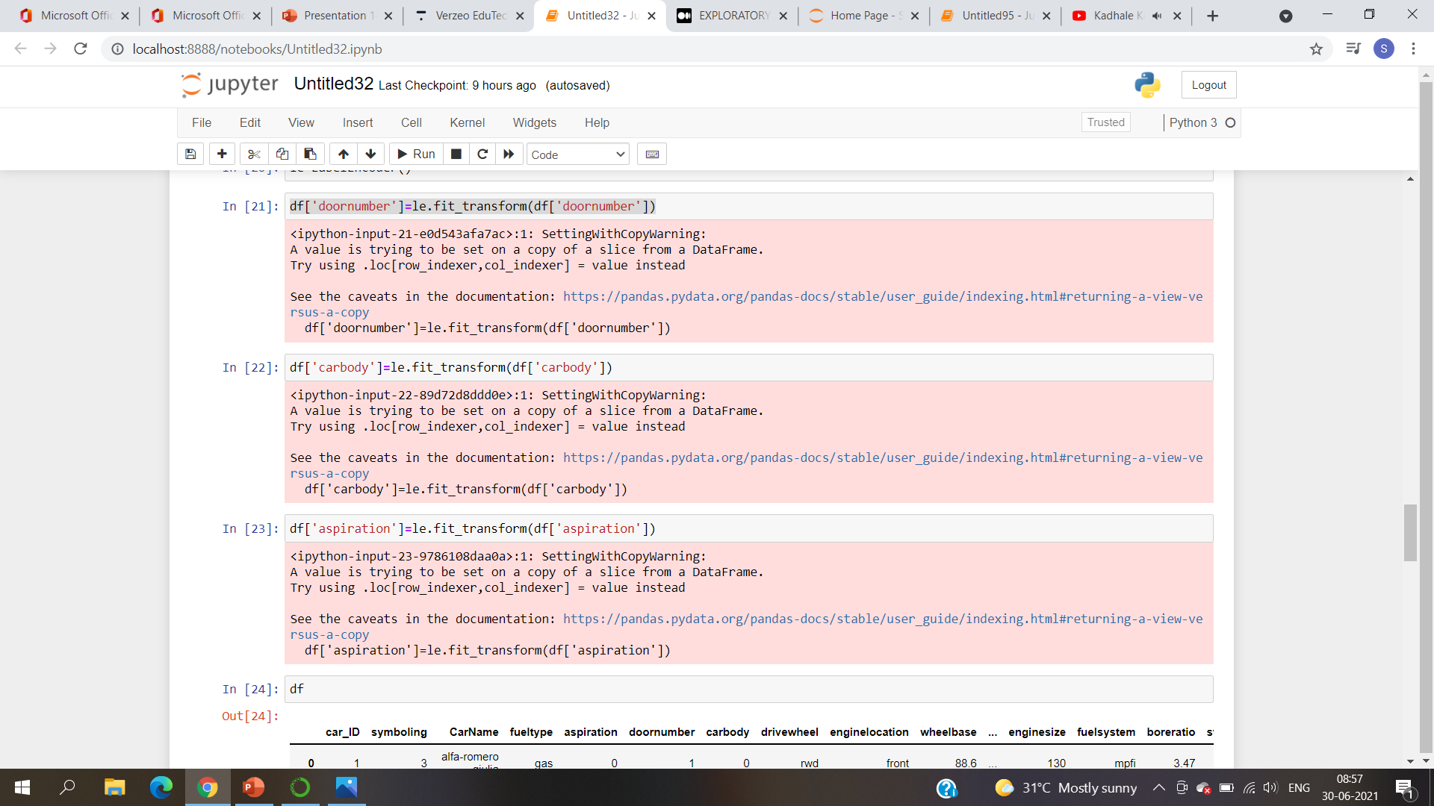
LABEL ENCODING:
To change the columns which are categorical values to numerical values. Like the categorical value has 4 classes(0,1,2,3)

Slide 17
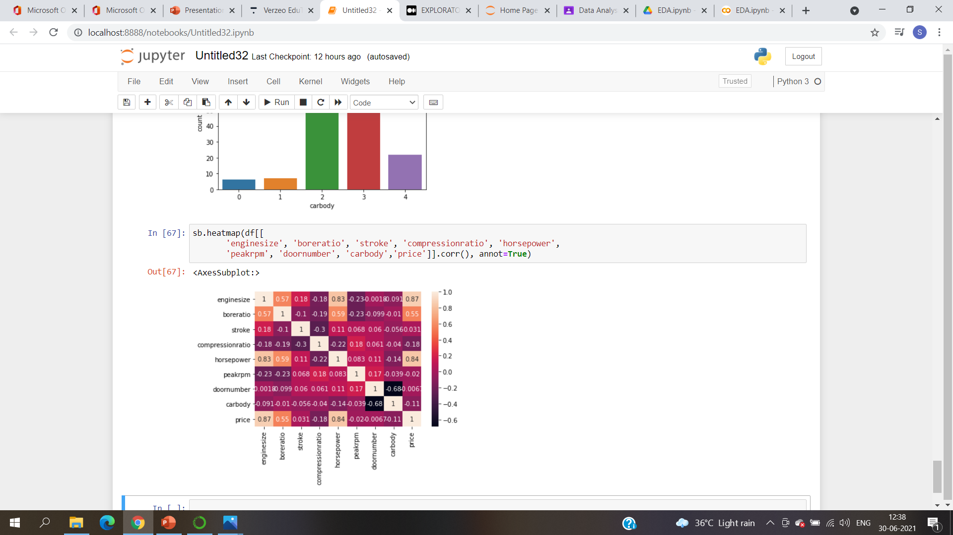
Importing seaborn and using heatmap to find correlation

Slide 18
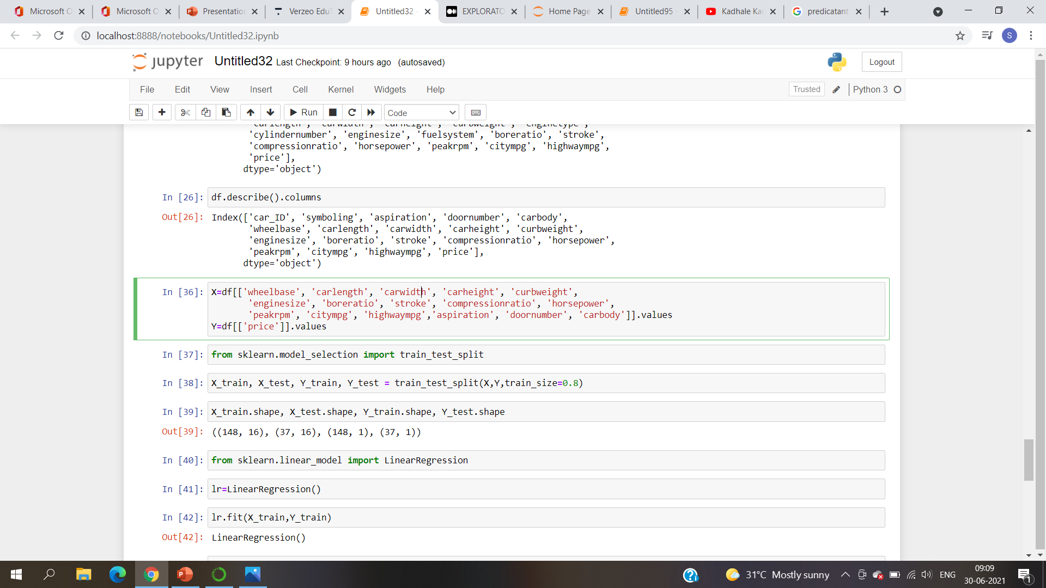
FEATURE SELECTION:
.values is important because it gives an numpy array ,numpy array is expected during training.

Slide 19
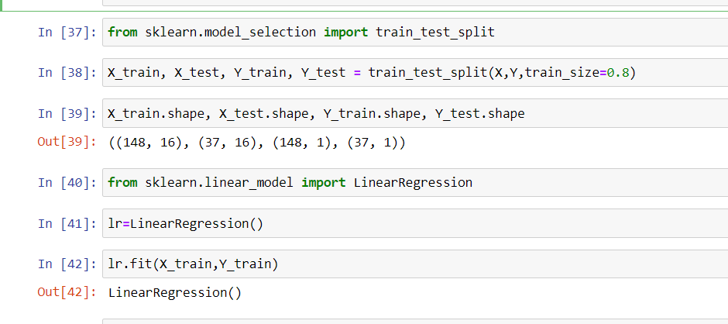
Splitting the data set into training and testing using train_test_split.
Applying LinearRegression here,because the price column is continuous and numerical

Slide 20
Fit function during training comes up with a mathematical equation

Slide 21
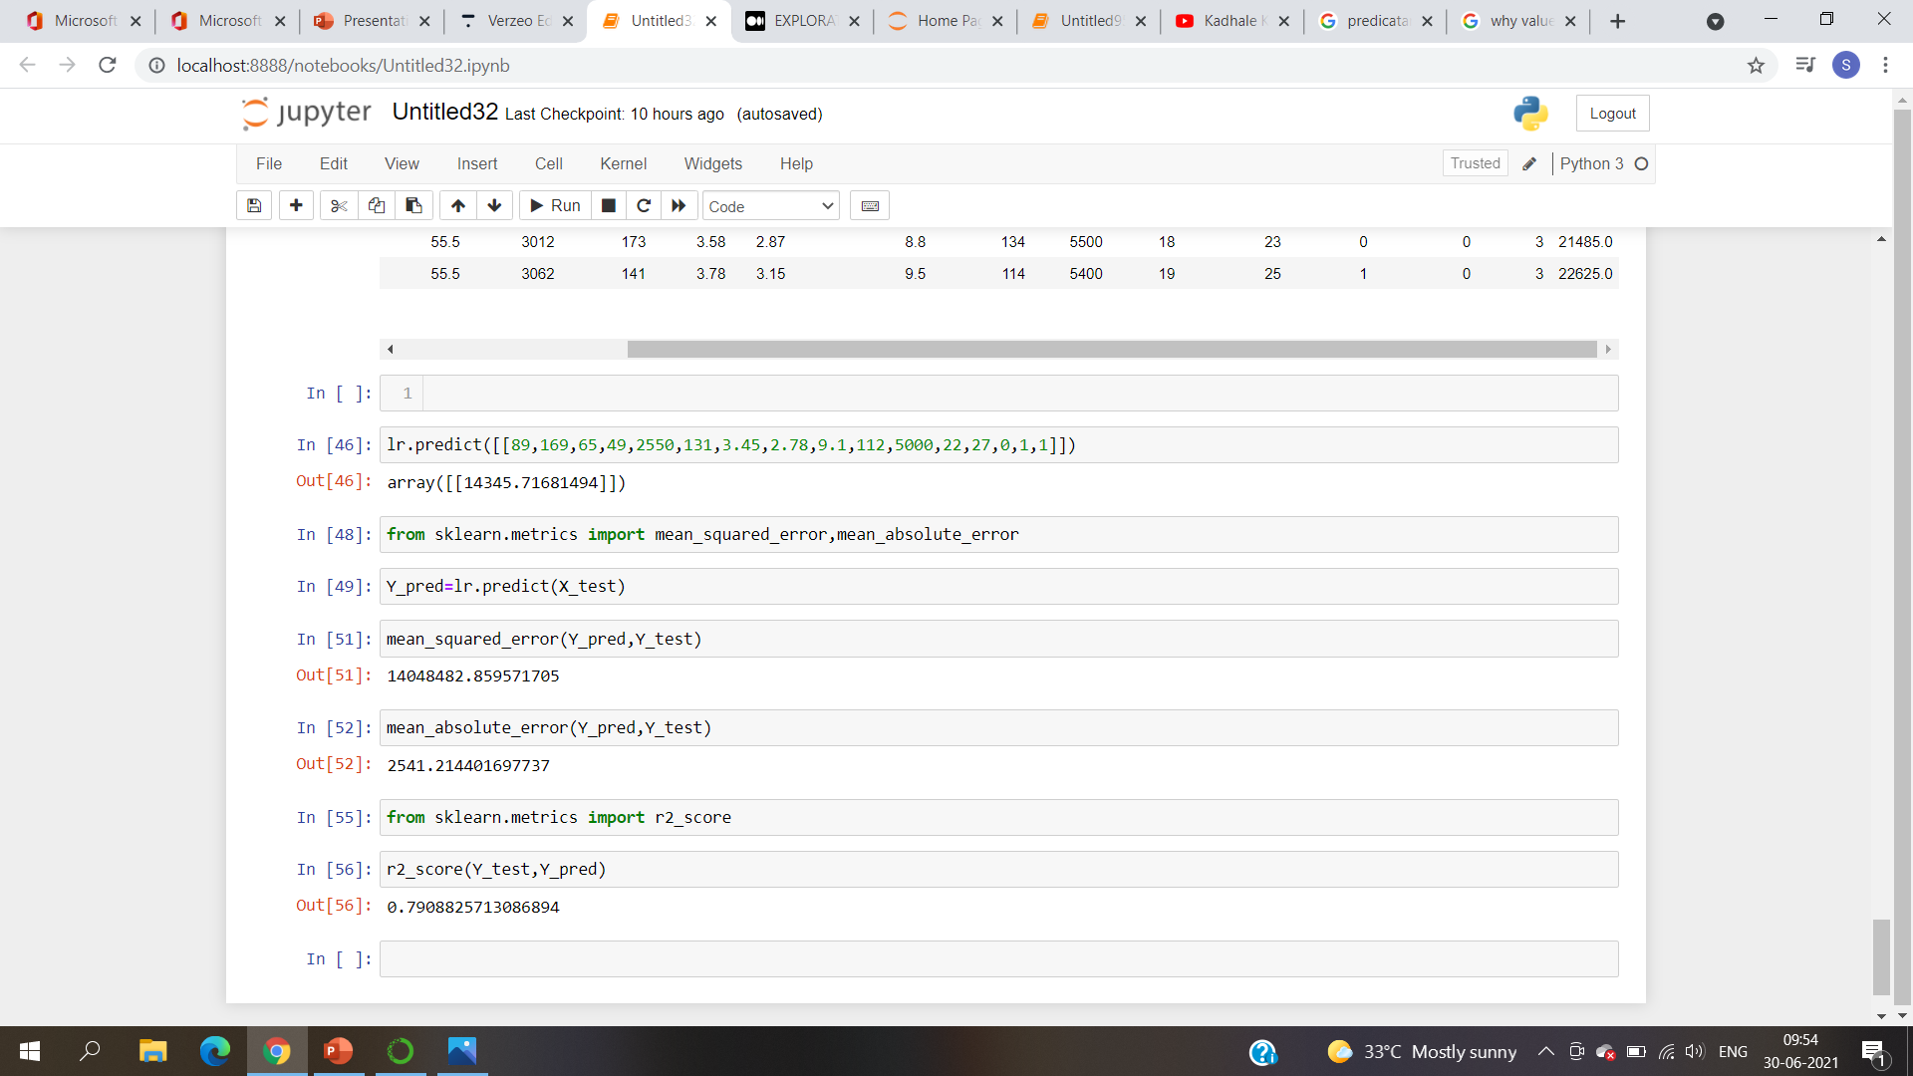
Predicting the price of a car

Slide 22
Predicting the testing set

Slide 23
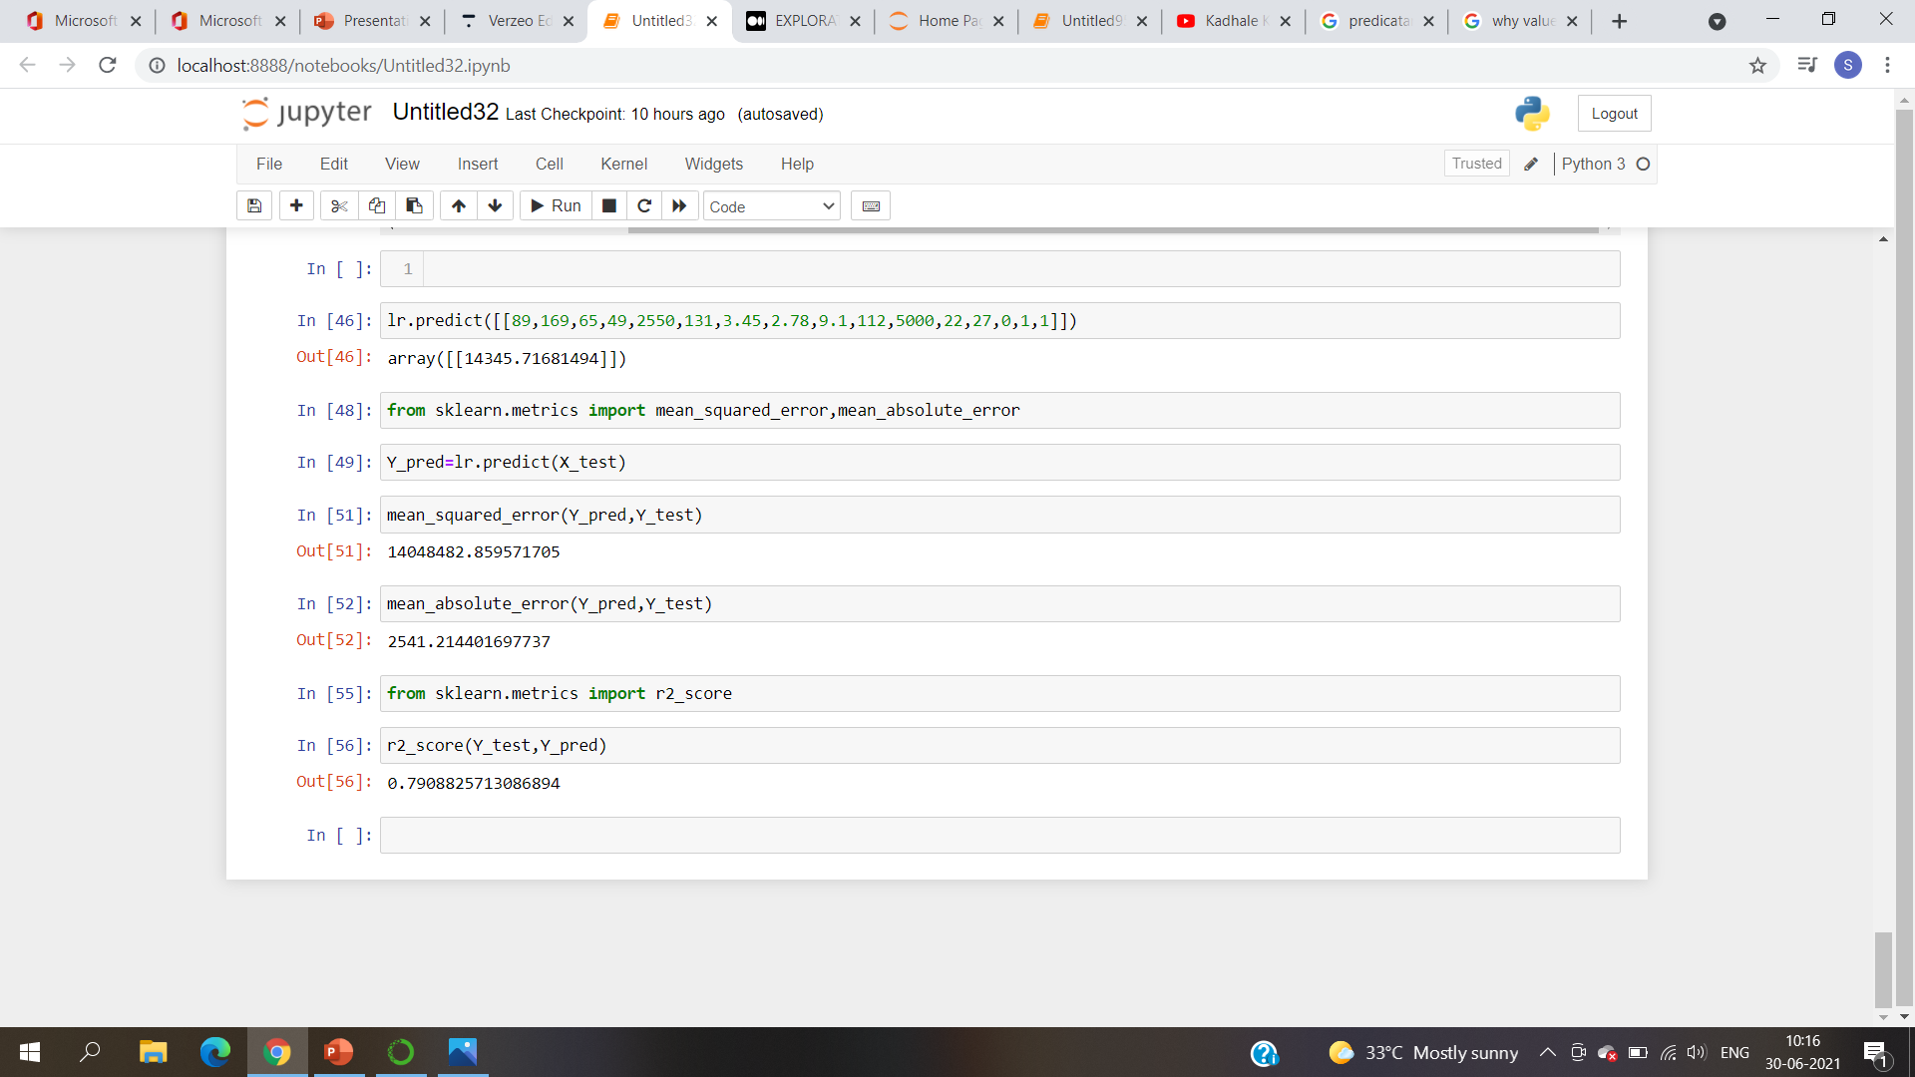
Evaluating metrics:
Mean squared error,mean absolute error

Slide 24
To evaluate the performance of linear regression :

